Slide 1


Standards of Risk Evidence Driven Behavior-Disease Model
Chenangnon Tovissode
IMCI Postdoc,
ctovissode@uidaho.edu
Prof Bert O. Baumgaertner
Department of Politics and Philosophy,
bbaum@uidaho.edu
March 17, 2023

Slide 2
Revisiting the specification of the prophylactic proportion function

Slide 3


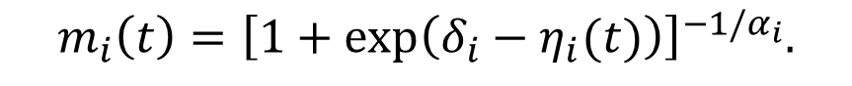



Definition of m_{i}
A Richards growth curve in terms of an information aggregate $η_{i}:$
$$m_{i}\left(t\right)={\left[1+\exp\left(δ_{i}−η_{i}(t)\right)\right]}^{−1/α_{i}}.$$
where $δ_{i}$ determines the prophylactic proportion when there is no perceived risk ($η_{i}\left(t\right)=0$), and $η_{i}$ measures the information effectively used by individuals in group $i$.
The information aggregate $η_{i}$ is defined at time $t$as a quadratic function of the perceived prevalence $P\left(t\right)$ and the relative change $Q\left(t\right)$in the number C$\left(t\right)$ of new confirmed positive cases:
$$η_{i}\left(t\right)=a_{pi}P\left(t\right)+u_{pi}{\left[P\left(t\right)\right]}^{2}+v_{i}P\left(t\right)Q\left(t\right)+u_{qi}{\left[Q\left(t\right)\right]}^{2}+a_{qi}Q\left(t\right).$$
where $a_{pi}$, $a_{qi}$, $u_{pi}$, $u_{qi}$, and $v_{i}$ are non-negative real coefficients expressing the weights of linear, quadratic and interaction components of $P\left(t\right)$ and $Q\left(t\right)$ in $η_{i}$.

Slide 4
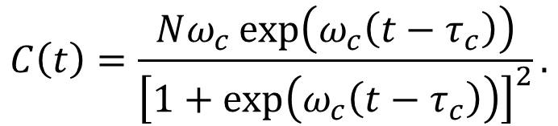

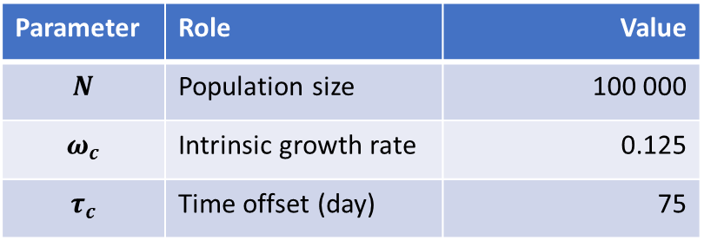

Visualisation of m_{i}
The basic pieces of information - perceived prevalence $P\left(t\right)$ and relative change $Q\left(t\right)$ in $C\left(t\right):$
Logistic number $C\left(t\right)$ of new confirmed positive cases:
$$C\left(t\right)=\frac{Nω_{c}\exp\left(ω_{c}\left(t−τ_{c}\right)\right)}{{\left[1+\exp\left(ω_{c}\left(t−τ_{c}\right)\right)\right]}^{2}}.$$
Parameter | Role | Value
$$N$$ | Population size | 100 000
$$ω_{c}$$ | Intrinsic growth rate | 0.125
$$τ_{c}$$ | Time offset (day) | 75

Slide 5


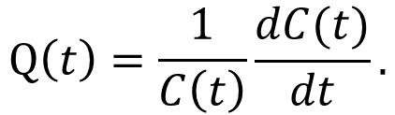
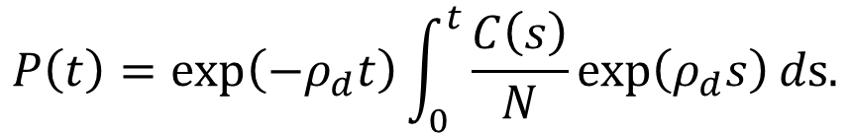
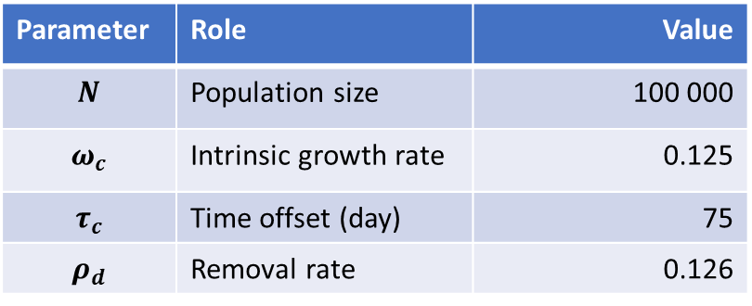
Visualisation of m_{i}
The basic pieces of information: perceived prevalence $P\left(t\right)$ and relative change $Q\left(t\right)$ in $C\left(t\right):$
Perceived prevalence $P\left(t\right)$ from $C\left(t\right)$:
$$P\left(t\right)=\exp\left(−ρ_{d}t\right)\int_{0}^{t}{\frac{C\left(s\right)}{N}\exp\left(ρ_{d}s\right)}ds.$$
$$Q\left(t\right)=\frac{1}{C\left(t\right)}\frac{dC(t)}{dt}.$$
Parameter | Role | Value
$$N$$ | Population size | 100 000
$$ω_{c}$$ | Intrinsic growth rate | 0.125
$$τ_{c}$$ | Time offset (day) | 75
$$ρ_{d}$$ | Removal rate | 0.126

Slide 6
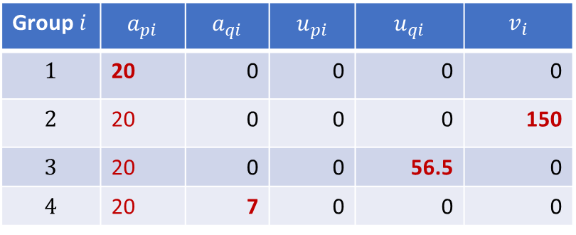
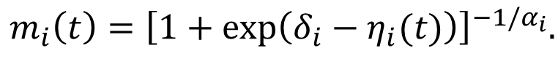
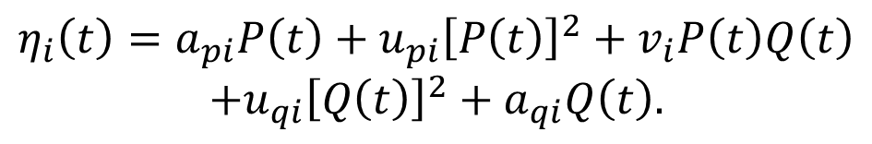
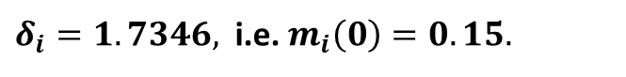
Visualisation of m_{i}
$$m_{i}\left(t\right)={\left[1+\exp\left(δ_{i}−η_{i}(t)\right)\right]}^{−1/α_{i}}.$$
$δ_{i}=1.7346,$ i.e. $m_{i}\left(0\right)=0.15.$
$$η_{i}\left(t\right)=a_{pi}P\left(t\right)+u_{pi}{\left[P\left(t\right)\right]}^{2}+v_{i}P\left(t\right)Q\left(t\right)$$
$$+u_{qi}{\left[Q\left(t\right)\right]}^{2}+a_{qi}Q\left(t\right).$$
Group $i$ | $$a_{pi}$$ | $$a_{qi}$$ | $$u_{pi}$$ | $$u_{qi}$$ | $$v_{i}$$
$$1$$ | 20 | 0 | 0 | 0 | 0
$$2$$ | 20 | 0 | 0 | 0 | 150
$$3$$ | 20 | 0 | 0 | 56.5 | 0
$$4$$ | 20 | 7 | 0 | 0 | 0

Slide 7
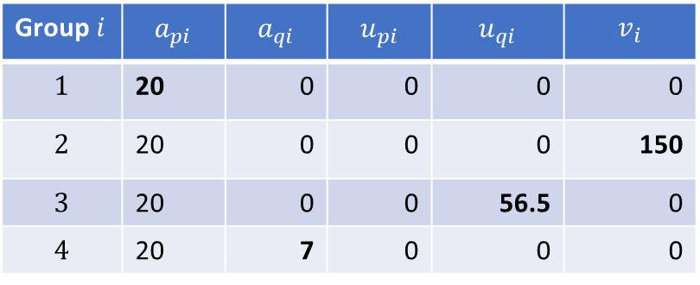
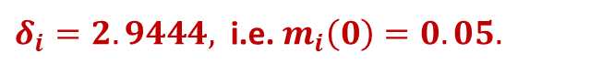
Visualisation of m_{i}
$$m_{i}\left(t\right)={\left[1+\exp\left(δ_{i}−η_{i}(t)\right)\right]}^{−1/α_{i}}.$$
$δ_{i}=2.9444,$ i.e. $m_{i}\left(0\right)=0.05.$
$$η_{i}\left(t\right)=a_{pi}P\left(t\right)+u_{pi}{\left[P\left(t\right)\right]}^{2}+v_{i}P\left(t\right)Q\left(t\right)$$
$$+u_{qi}{\left[Q\left(t\right)\right]}^{2}+a_{qi}Q\left(t\right).$$
Group $i$ | $$a_{pi}$$ | $$a_{qi}$$ | $$u_{pi}$$ | $$u_{qi}$$ | $$v_{i}$$
$$1$$ | 20 | 0 | 0 | 0 | 0
$$2$$ | 20 | 0 | 0 | 0 | 150
$$3$$ | 20 | 0 | 0 | 56.5 | 0
$$4$$ | 20 | 7 | 0 | 0 | 0

Slide 8
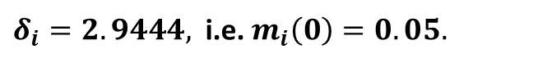
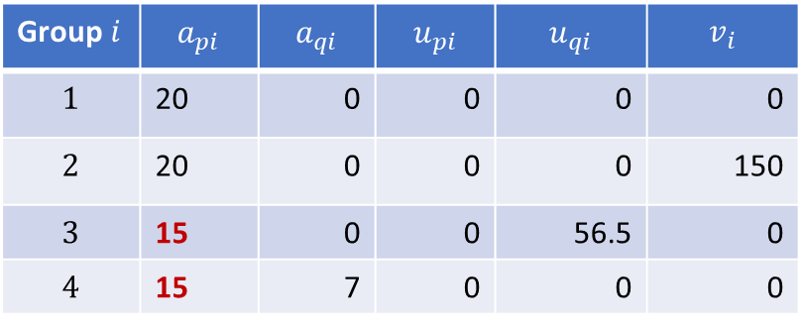
Visualisation of m_{i}
$$m_{i}\left(t\right)={\left[1+\exp\left(δ_{i}−η_{i}(t)\right)\right]}^{−1/α_{i}}.$$
$δ_{i}=2.9444,$ i.e. $m_{i}\left(0\right)=0.05.$
$$η_{i}\left(t\right)=a_{pi}P\left(t\right)+u_{pi}{\left[P\left(t\right)\right]}^{2}+v_{i}P\left(t\right)Q\left(t\right)$$
$$+u_{qi}{\left[Q\left(t\right)\right]}^{2}+a_{qi}Q\left(t\right).$$
Group $i$ | $$a_{pi}$$ | $$a_{qi}$$ | $$u_{pi}$$ | $$u_{qi}$$ | $$v_{i}$$
$$1$$ | 20 | 0 | 0 | 0 | 0
$$2$$ | 20 | 0 | 0 | 0 | 150
$$3$$ | 15 | 0 | 0 | 56.5 | 0
$$4$$ | 15 | 7 | 0 | 0 | 0

Slide 9
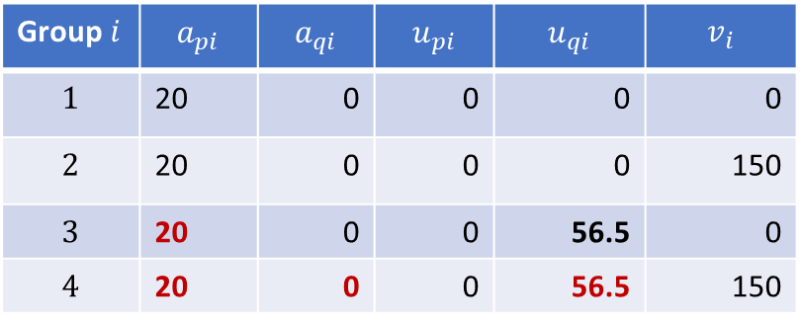
Visualisation of m_{i}
$$m_{i}\left(t\right)={\left[1+\exp\left(δ_{i}−η_{i}(t)\right)\right]}^{−1/α_{i}}.$$
$δ_{i}=2.9444,$ i.e. $m_{i}\left(0\right)=0.05.$
$$η_{i}\left(t\right)=a_{pi}P\left(t\right)+u_{pi}{\left[P\left(t\right)\right]}^{2}+v_{i}P\left(t\right)Q\left(t\right)$$
$$+u_{qi}{\left[Q\left(t\right)\right]}^{2}+a_{qi}Q\left(t\right).$$
Group $i$ | $$a_{pi}$$ | $$a_{qi}$$ | $$u_{pi}$$ | $$u_{qi}$$ | $$v_{i}$$
$$1$$ | 20 | 0 | 0 | 0 | 0
$$2$$ | 20 | 0 | 0 | 0 | 150
$$3$$ | 20 | 0 | 0 | 56.5 | 0
$$4$$ | 20 | 0 | 0 | 56.5 | 150

Slide 10
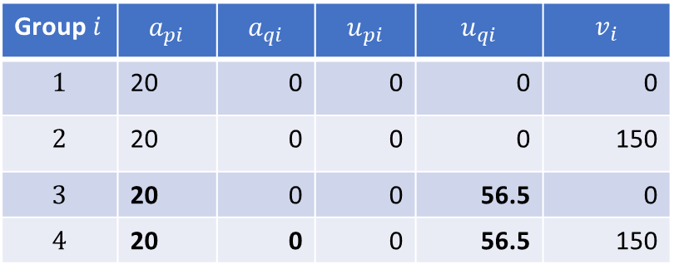
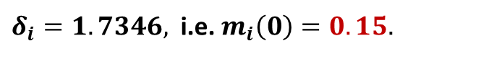
Visualisation of m_{i}
$$m_{i}\left(t\right)={\left[1+\exp\left(δ_{i}−η_{i}(t)\right)\right]}^{−1/α_{i}}.$$
$δ_{i}=1.7346,$ i.e. $m_{i}\left(0\right)=0.15.$
$$η_{i}\left(t\right)=a_{pi}P\left(t\right)+u_{pi}{\left[P\left(t\right)\right]}^{2}+v_{i}P\left(t\right)Q\left(t\right)$$
$$+u_{qi}{\left[Q\left(t\right)\right]}^{2}+a_{qi}Q\left(t\right).$$
Group $i$ | $$a_{pi}$$ | $$a_{qi}$$ | $$u_{pi}$$ | $$u_{qi}$$ | $$v_{i}$$
$$1$$ | 20 | 0 | 0 | 0 | 0
$$2$$ | 20 | 0 | 0 | 0 | 150
$$3$$ | 20 | 0 | 0 | 56.5 | 0
$$4$$ | 20 | 0 | 0 | 56.5 | 150

Slide 11
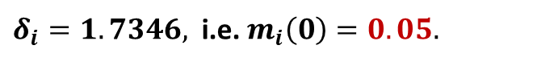
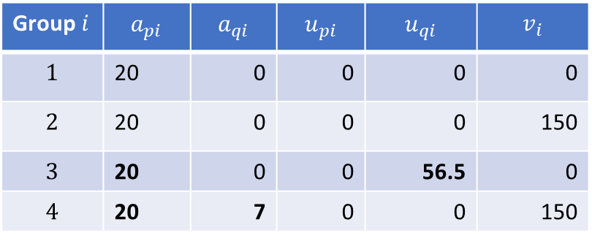
Visualisation of m_{i}
$$m_{i}\left(t\right)={\left[1+\exp\left(δ_{i}−η_{i}(t)\right)\right]}^{−1/α_{i}}.$$
$δ_{i}=1.7346,$ i.e. $m_{i}\left(0\right)=0.05.$
$$η_{i}\left(t\right)=a_{pi}P\left(t\right)+u_{pi}{\left[P\left(t\right)\right]}^{2}+v_{i}P\left(t\right)Q\left(t\right)$$
$$+u_{qi}{\left[Q\left(t\right)\right]}^{2}+a_{qi}Q\left(t\right).$$
Group $i$ | $$a_{pi}$$ | $$a_{qi}$$ | $$u_{pi}$$ | $$u_{qi}$$ | $$v_{i}$$
$$1$$ | 20 | 0 | 0 | 0 | 0
$$2$$ | 20 | 0 | 0 | 0 | 150
$$3$$ | 20 | 0 | 0 | 56.5 | 0
$$4$$ | 20 | 7 | 0 | 0 | 150

Slide 12
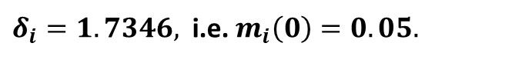
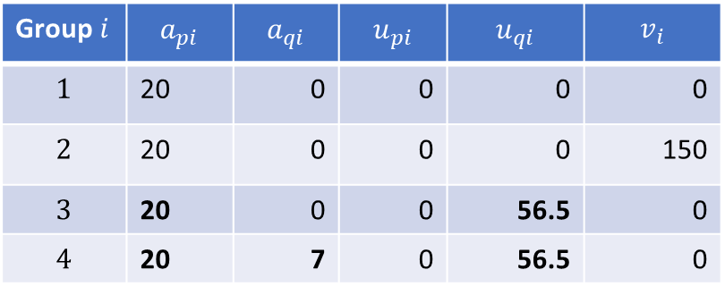
Visualisation of m_{i}
$$m_{i}\left(t\right)={\left[1+\exp\left(δ_{i}−η_{i}(t)\right)\right]}^{−1/α_{i}}.$$
$δ_{i}=1.7346,$ i.e. $m_{i}\left(0\right)=0.05.$
$$η_{i}\left(t\right)=a_{pi}P\left(t\right)+u_{pi}{\left[P\left(t\right)\right]}^{2}+v_{i}P\left(t\right)Q\left(t\right)$$
$$+u_{qi}{\left[Q\left(t\right)\right]}^{2}+a_{qi}Q\left(t\right).$$
Group $i$ | $$a_{pi}$$ | $$a_{qi}$$ | $$u_{pi}$$ | $$u_{qi}$$ | $$v_{i}$$
$$1$$ | 20 | 0 | 0 | 0 | 0
$$2$$ | 20 | 0 | 0 | 0 | 150
$$3$$ | 20 | 0 | 0 | 56.5 | 0
$$4$$ | 20 | 7 | 0 | 56.5 | 0

Slide 14
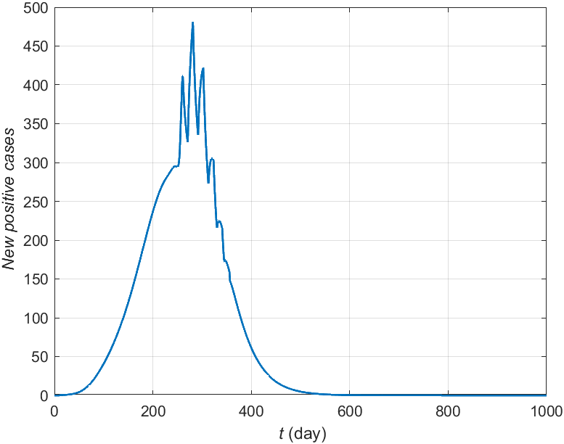
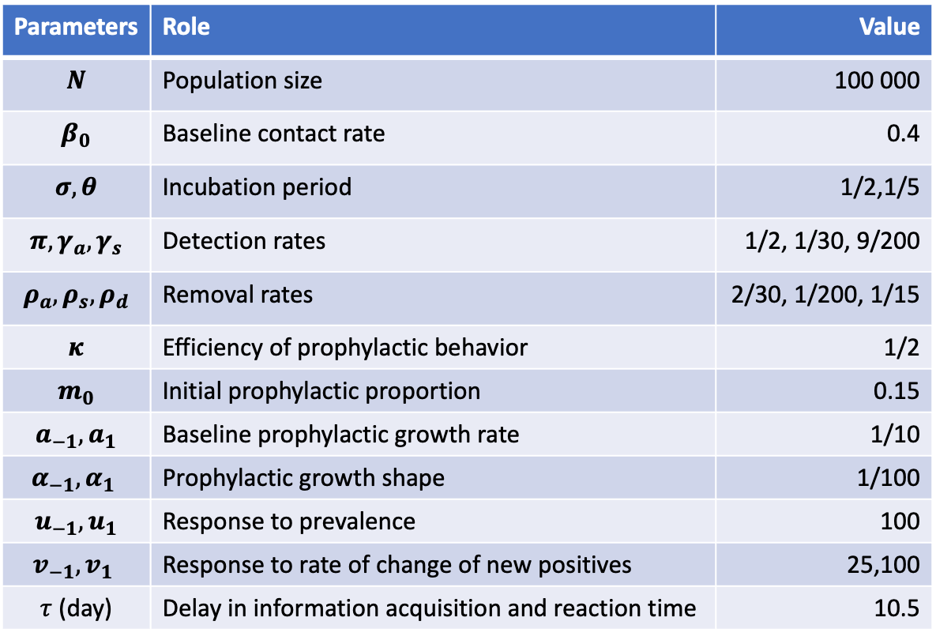
Scenario A
Parameters | Role | Value
$$N$$ | Population size | 100 000
$$β_{0}$$ | Baseline contact rate | 0.4
$$σ,θ$$ | Incubation period | 1/2,1/5
$$π,γ_{a},γ_{s}$$ | Detection rates | 1/2, 1/30, 9/200
$$ρ_{a},ρ_{s},ρ_{d}$$ | Removal rates | 2/30, 1/200, 1/15
$$κ$$ | Efficiency of prophylactic behavior | 1/2
$$m_{0}$$ | Initial prophylactic proportion | 0.15
$$a_{−1},a_{1}$$ | Baseline prophylactic growth rate | 1/10
$$α_{−1},α_{1}$$ | Prophylactic growth shape | 1/100
$$u_{−1},u_{1}$$ | Response to prevalence | 100
$$v_{−1},v_{1}$$ | Response to rate of change of new positives | 25,100
$τ$ (day) | Delay in information acquisition and reaction time | 10.5

Slide 15
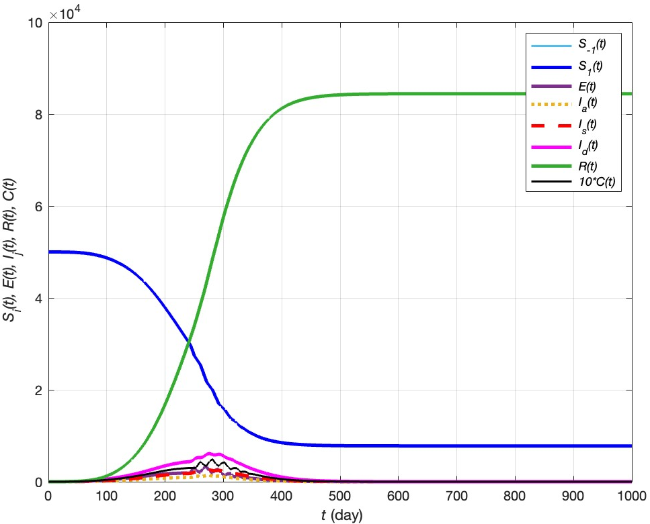


Scenario A
${\text{Max}\text{(}C}_{t})=$ 493 new positives
$$R_{∞}\sim 84.42\%$$

Slide 16
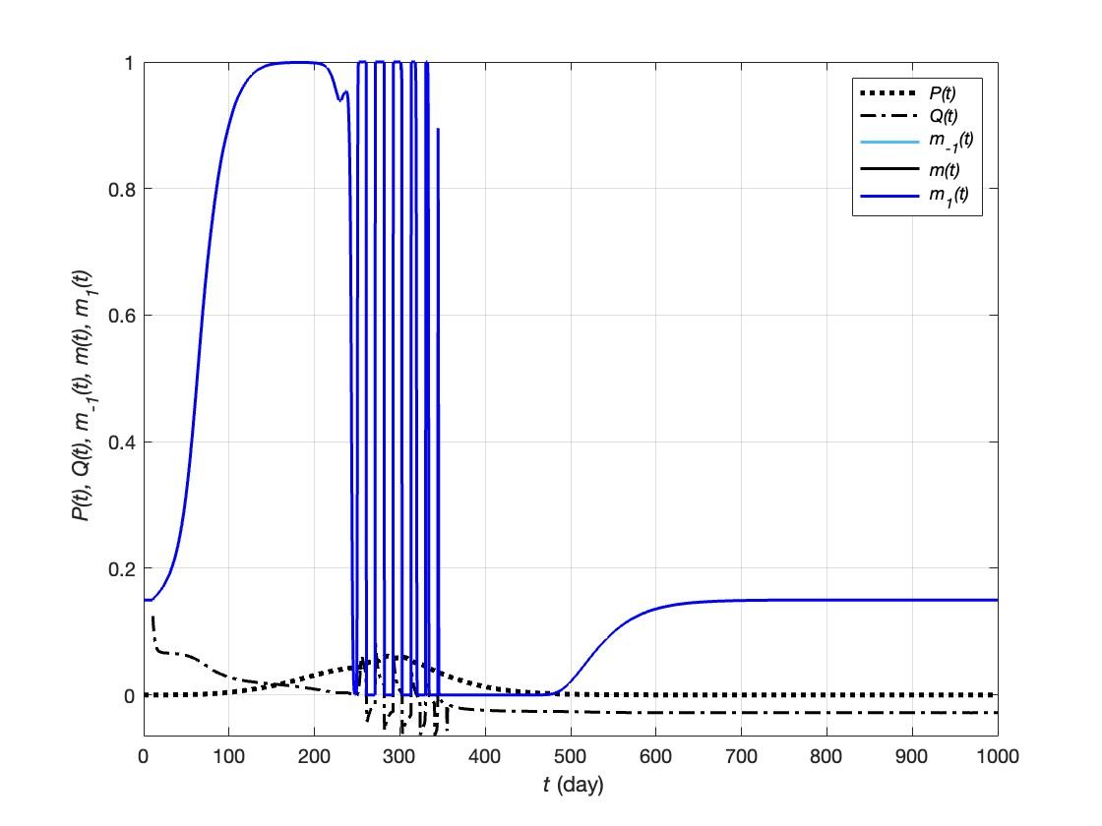
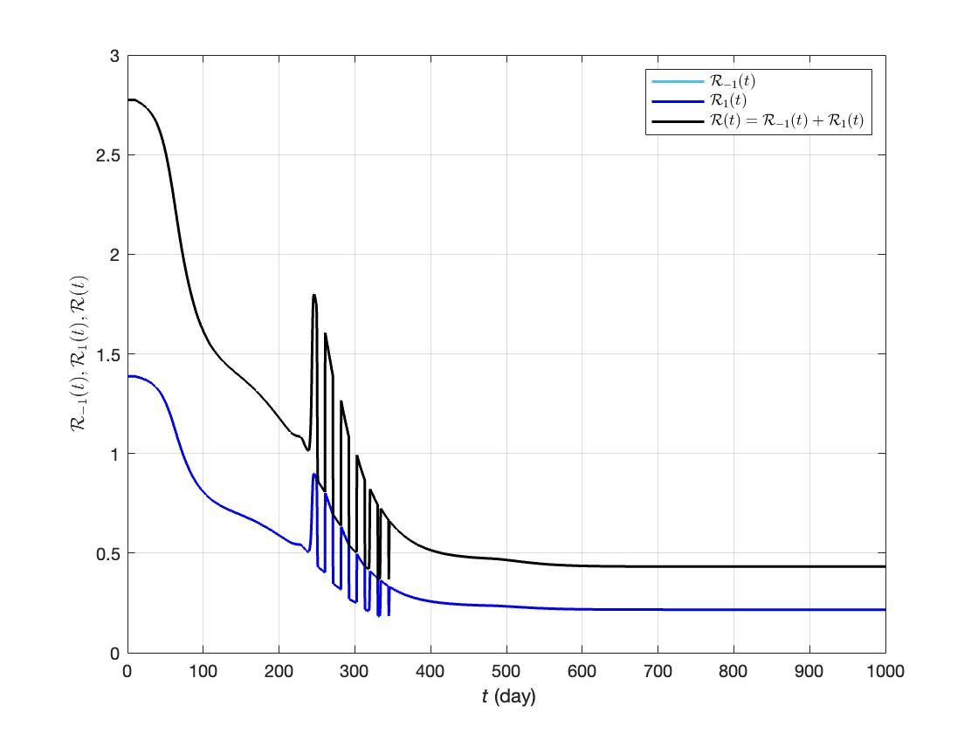
Scenario A

Slide 17
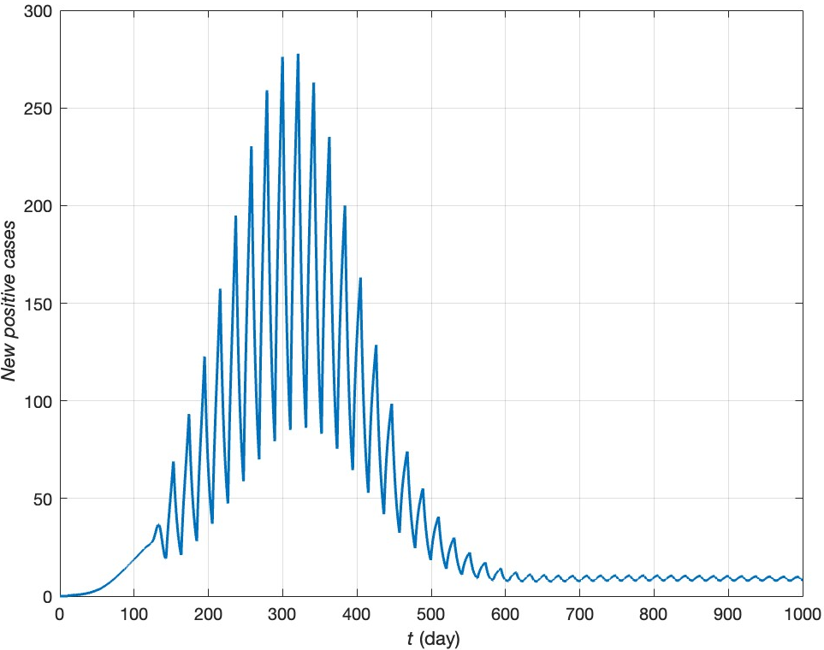

Scenario A’
Parameters | Role | Value
$$N$$ | Population size | 100 000
$$β_{0}$$ | Baseline contact rate | 0.2
$$σ,θ$$ | Incubation period | 1/2,1/5
$$π,γ_{a},γ_{s}$$ | Detection rates | 1/2, 1/30, 9/200
$$ρ_{a},ρ_{s},ρ_{d}$$ | Removal rates | 2/30, 1/200, 1/15
$$κ$$ | Efficiency of prophylactic behavior | 1/2 → 1
$$m_{0}$$ | Initial prophylactic proportion | 0.15
$$a_{−1},a_{1}$$ | Baseline prophylactic growth rate | 1/10
$$α_{−1},α_{1}$$ | Prophylactic growth shape | 1/100
$$u_{−1},u_{1}$$ | Response to prevalence | 100
$$v_{−1},v_{1}$$ | Response to rate of change of new positives | 25,100
$τ$ (day) | Delay in information acquisition and reaction time | 10.5

Slide 18
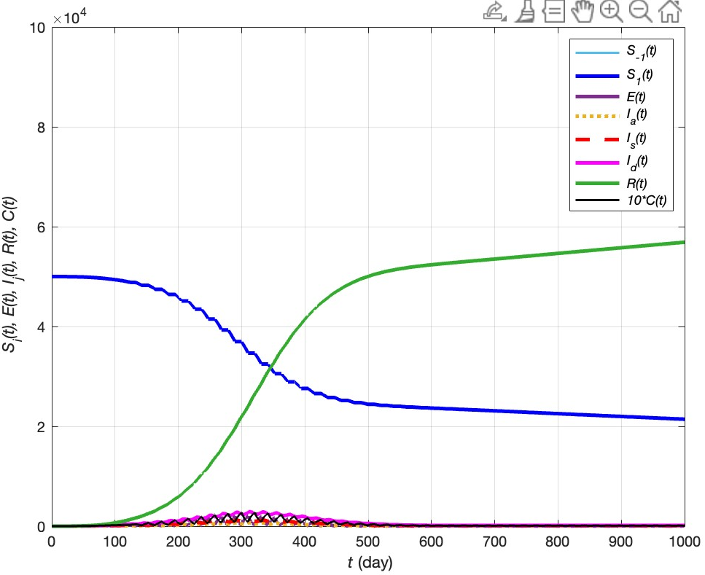


Scenario A’
${\text{Max}\text{(}C}_{t})=$ 280 new positives
$$R_{∞}\sim 65.05\%$$

Slide 19
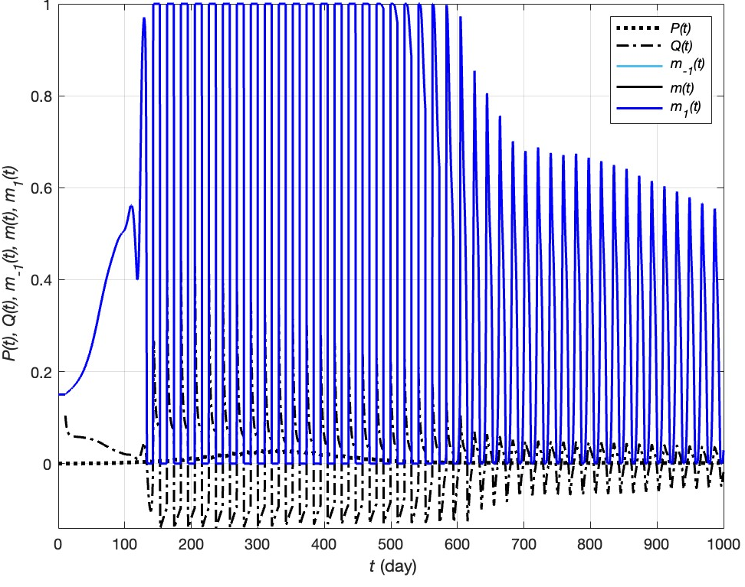
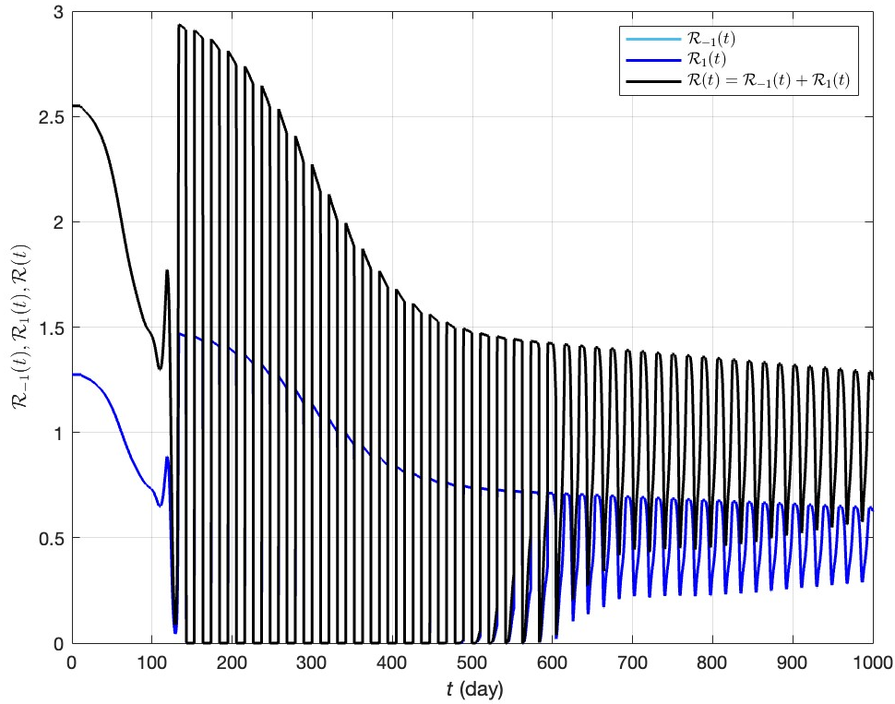
Scenario A’

Slide 20
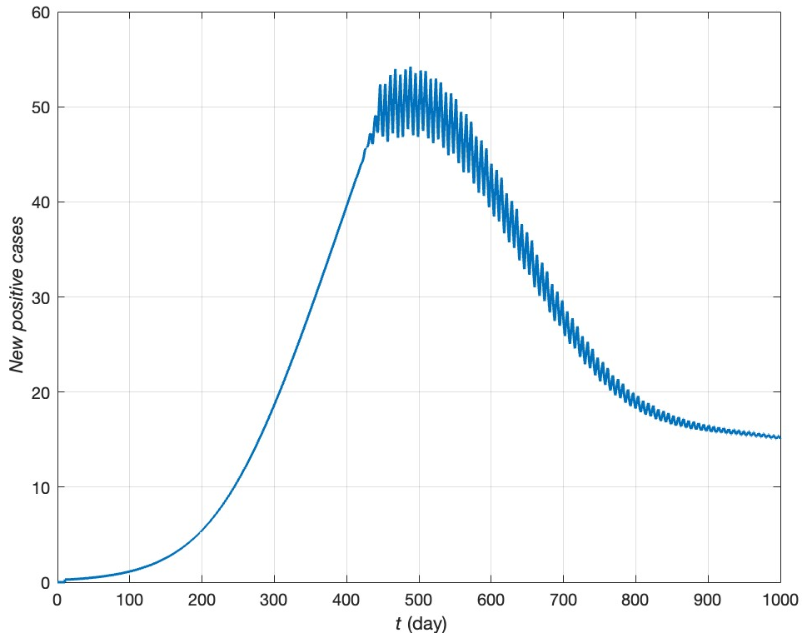
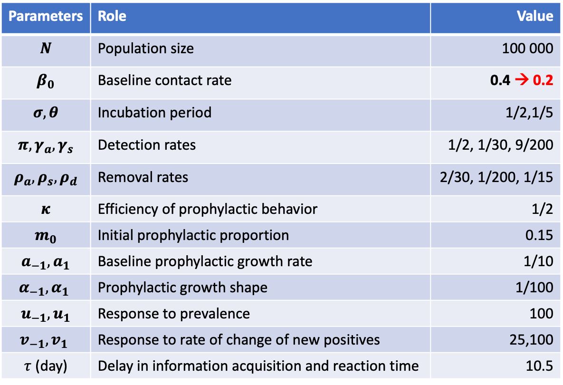
Scenario A’’
Parameters | Role | Value
$$N$$ | Population size | 100 000
$$β_{0}$$ | Baseline contact rate | 0.4 → 0.2
$$σ,θ$$ | Incubation period | 1/2,1/5
$$π,γ_{a},γ_{s}$$ | Detection rates | 1/2, 1/30, 9/200
$$ρ_{a},ρ_{s},ρ_{d}$$ | Removal rates | 2/30, 1/200, 1/15
$$κ$$ | Efficiency of prophylactic behavior | 1/2
$$m_{0}$$ | Initial prophylactic proportion | 0.15
$$a_{−1},a_{1}$$ | Baseline prophylactic growth rate | 1/10
$$α_{−1},α_{1}$$ | Prophylactic growth shape | 1/100
$$u_{−1},u_{1}$$ | Response to prevalence | 100
$$v_{−1},v_{1}$$ | Response to rate of change of new positives | 25,100
$τ$ (day) | Delay in information acquisition and reaction time | 10.5

Slide 21
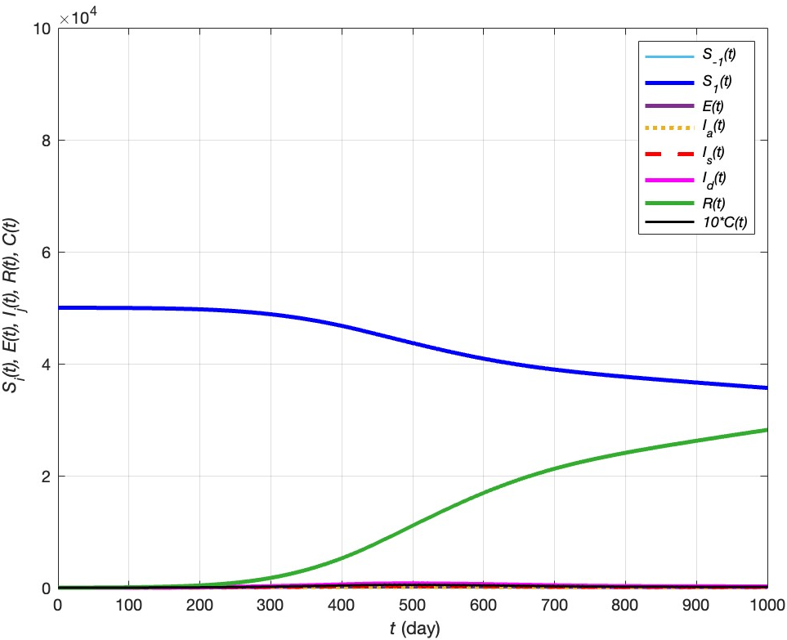


Scenario A’’
${\text{Max}\text{(}C}_{t})=$ 54 new positives
$$R_{∞}\sim 35.99\%$$

Slide 22
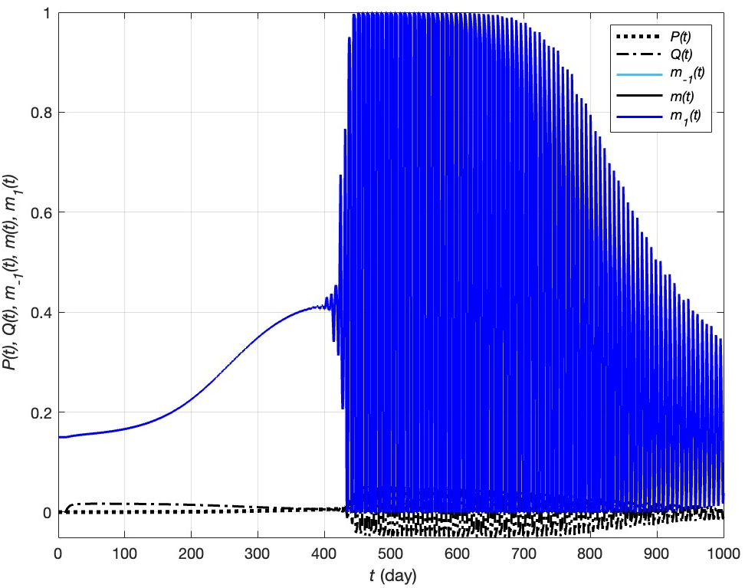
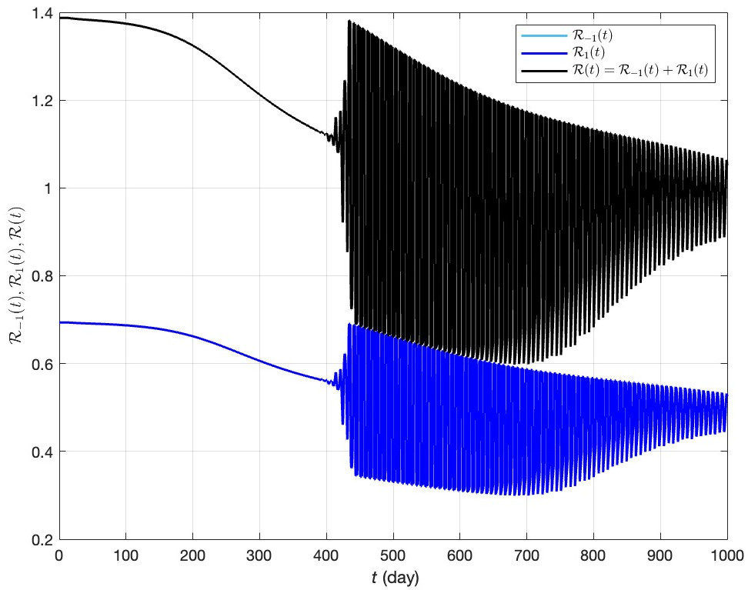
Scenario A’’

Slide 23
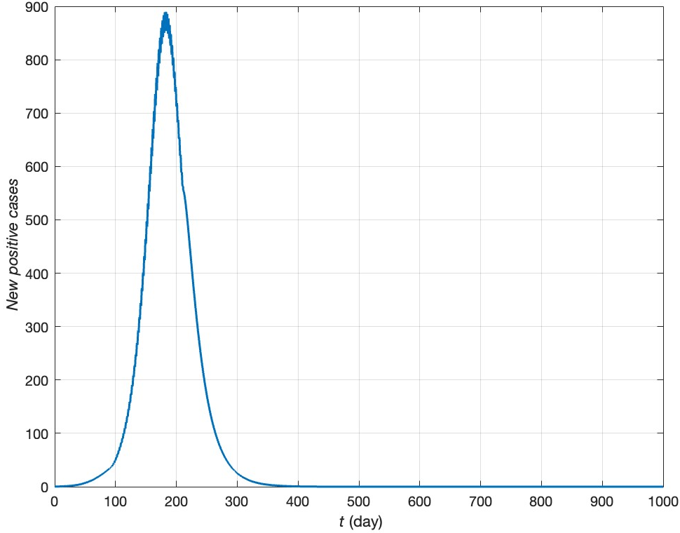
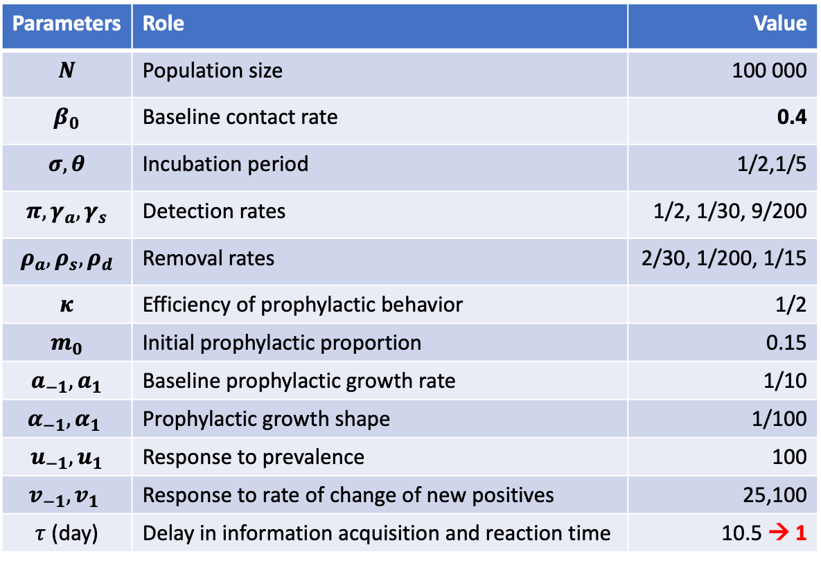
Scenario A’’’
Parameters | Role | Value
$$N$$ | Population size | 100 000
$$β_{0}$$ | Baseline contact rate | 0.4
$$σ,θ$$ | Incubation period | 1/2,1/5
$$π,γ_{a},γ_{s}$$ | Detection rates | 1/2, 1/30, 9/200
$$ρ_{a},ρ_{s},ρ_{d}$$ | Removal rates | 2/30, 1/200, 1/15
$$κ$$ | Efficiency of prophylactic behavior | 1/2
$$m_{0}$$ | Initial prophylactic proportion | 0.15
$$a_{−1},a_{1}$$ | Baseline prophylactic growth rate | 1/10
$$α_{−1},α_{1}$$ | Prophylactic growth shape | 1/100
$$u_{−1},u_{1}$$ | Response to prevalence | 100
$$v_{−1},v_{1}$$ | Response to rate of change of new positives | 25,100
$τ$ (day) | Delay in information acquisition and reaction time | 10.5 → 1

Slide 24
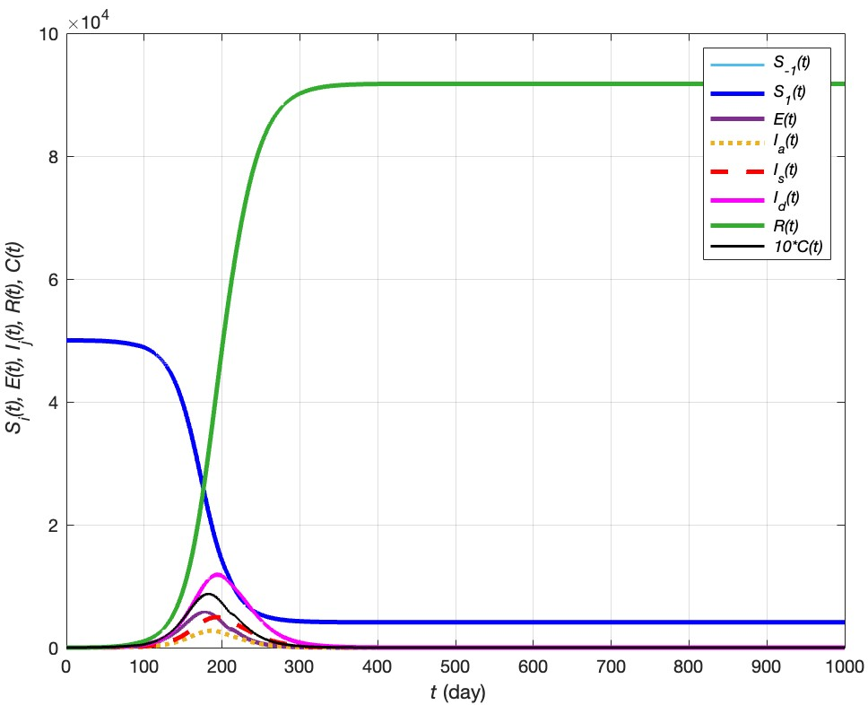




Scenario A’’’
${\text{Max}\text{(}C}_{t})=$ 890 new positives
$$R_{∞}\sim 91.77\%$$
$VS. R_{∞}\sim 84.42\%$ for $τ=10.5$
${\text{VS}\text{.} \text{Max}\text{(}C}_{t})=$ 493 new positives

Slide 25
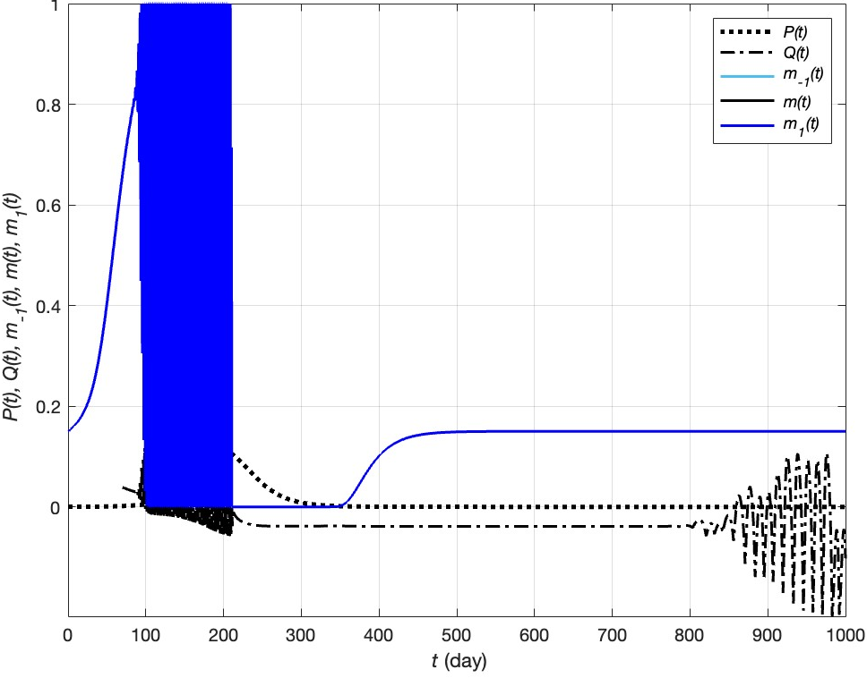
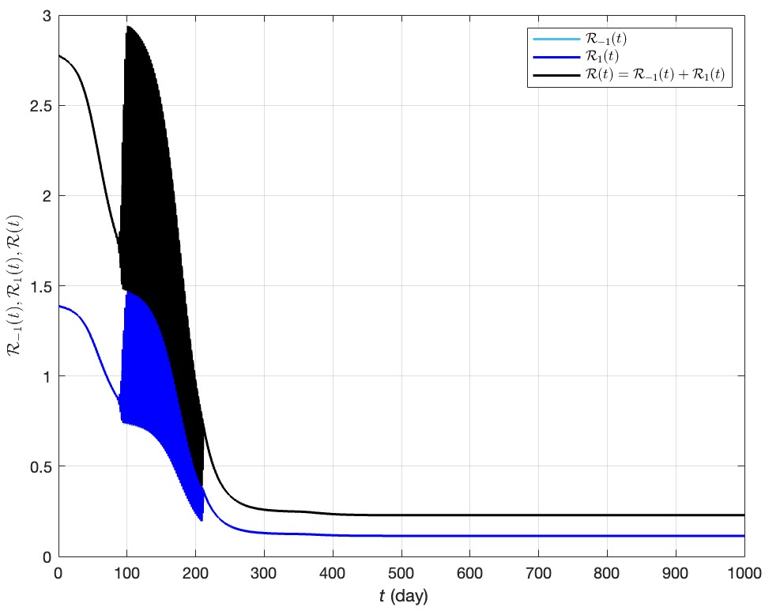
Scenario A’’’

Slide 26
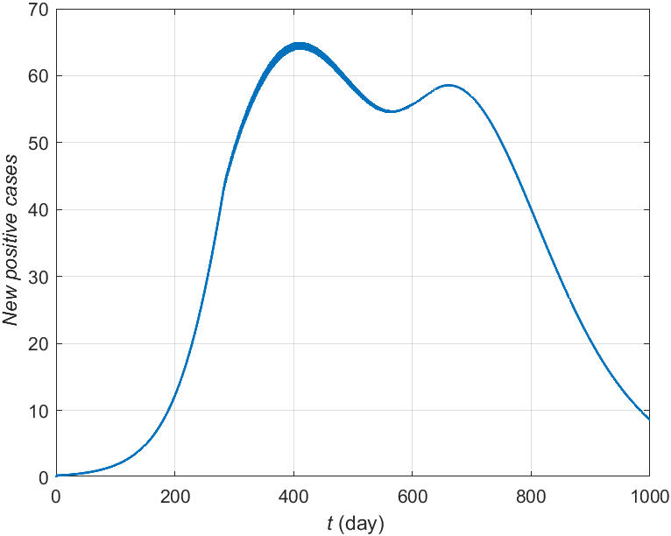
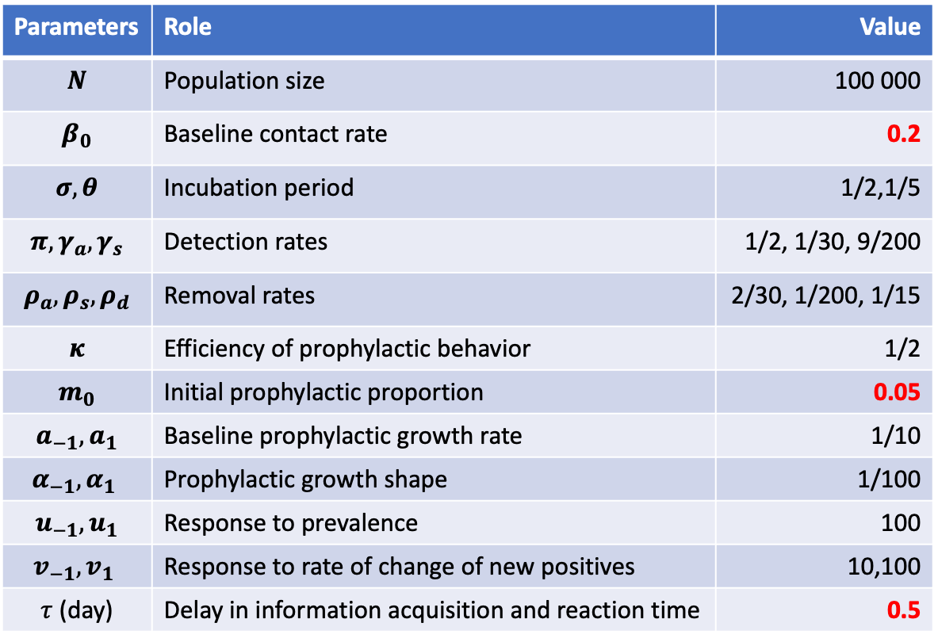
Scenario B
Parameters | Role | Value
$$N$$ | Population size | 100 000
$$β_{0}$$ | Baseline contact rate | 0.2
$$σ,θ$$ | Incubation period | 1/2,1/5
$$π,γ_{a},γ_{s}$$ | Detection rates | 1/2, 1/30, 9/200
$$ρ_{a},ρ_{s},ρ_{d}$$ | Removal rates | 2/30, 1/200, 1/15
$$κ$$ | Efficiency of prophylactic behavior | 1/2
$$m_{0}$$ | Initial prophylactic proportion | 0.05
$$a_{−1},a_{1}$$ | Baseline prophylactic growth rate | 1/10
$$α_{−1},α_{1}$$ | Prophylactic growth shape | 1/100
$$u_{−1},u_{1}$$ | Response to prevalence | 100
$$v_{−1},v_{1}$$ | Response to rate of change of new positives | 10,100
$τ$ (day) | Delay in information acquisition and reaction time | 0.5

Slide 27
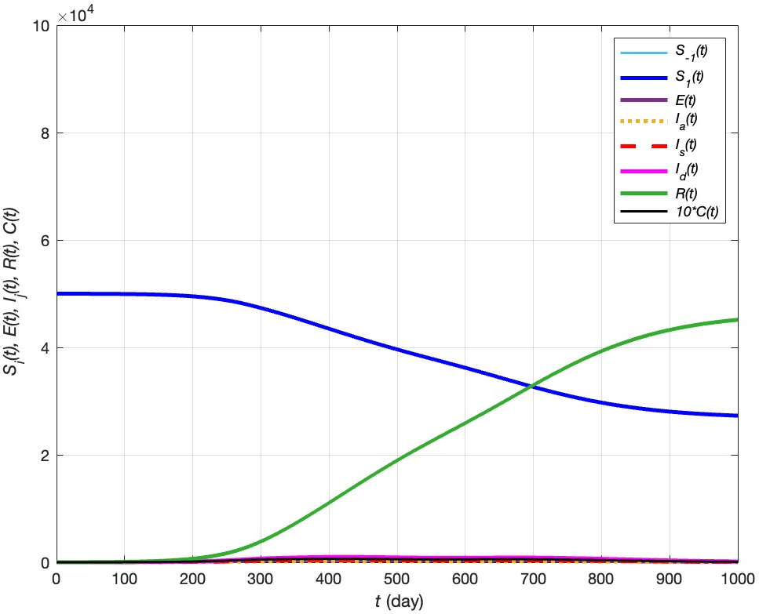


Scenario B
${\text{Max}\text{(}C}_{t})=66$ new positives
$$R_{∞}\sim 45.14\%$$

Slide 28
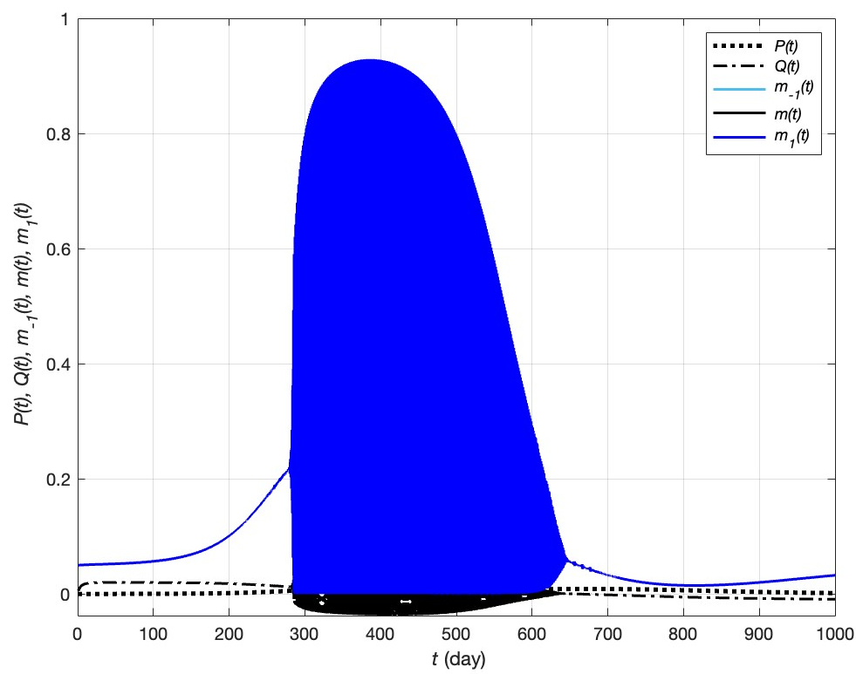
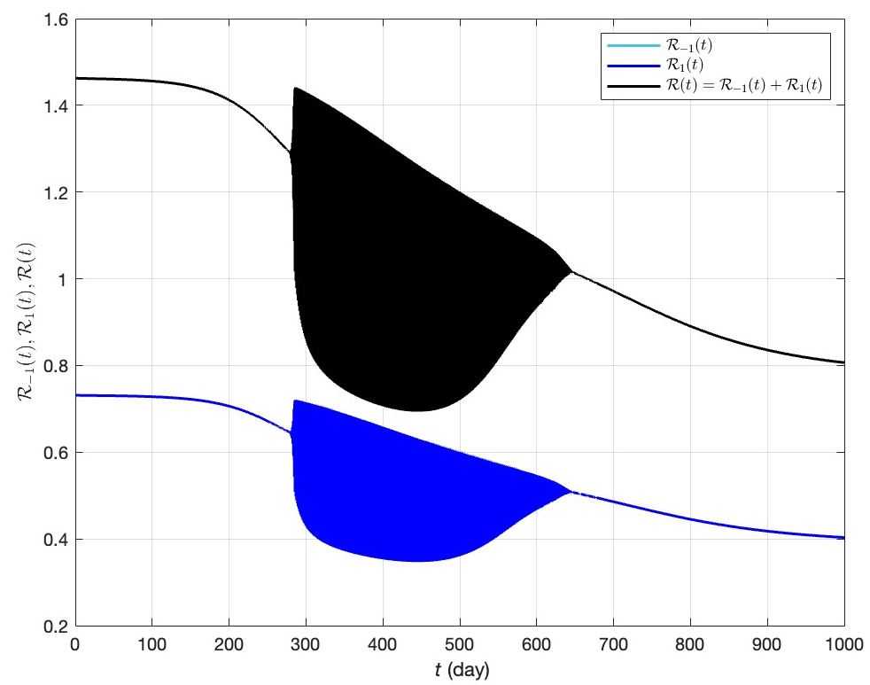
Scenario B

Slide 29
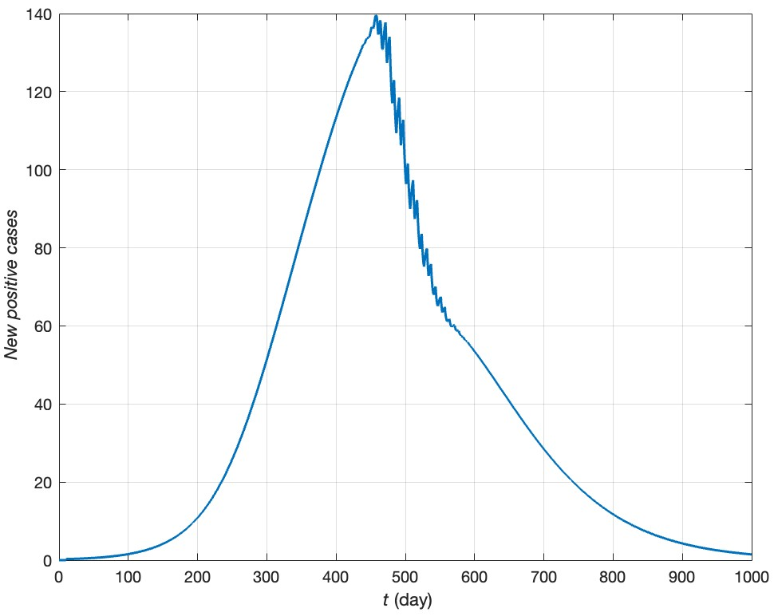
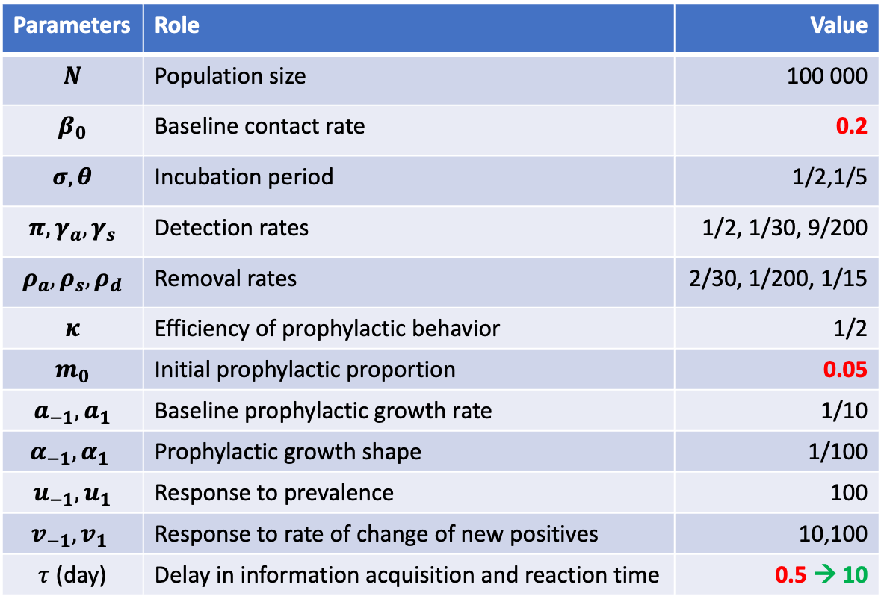
Scenario B’
Parameters | Role | Value
$$N$$ | Population size | 100 000
$$β_{0}$$ | Baseline contact rate | 0.2
$$σ,θ$$ | Incubation period | 1/2,1/5
$$π,γ_{a},γ_{s}$$ | Detection rates | 1/2, 1/30, 9/200
$$ρ_{a},ρ_{s},ρ_{d}$$ | Removal rates | 2/30, 1/200, 1/15
$$κ$$ | Efficiency of prophylactic behavior | 1/2
$$m_{0}$$ | Initial prophylactic proportion | 0.05
$$a_{−1},a_{1}$$ | Baseline prophylactic growth rate | 1/10
$$α_{−1},α_{1}$$ | Prophylactic growth shape | 1/100
$$u_{−1},u_{1}$$ | Response to prevalence | 100
$$v_{−1},v_{1}$$ | Response to rate of change of new positives | 10,100
$τ$ (day) | Delay in information acquisition and reaction time | 0.5 → 10

Slide 30
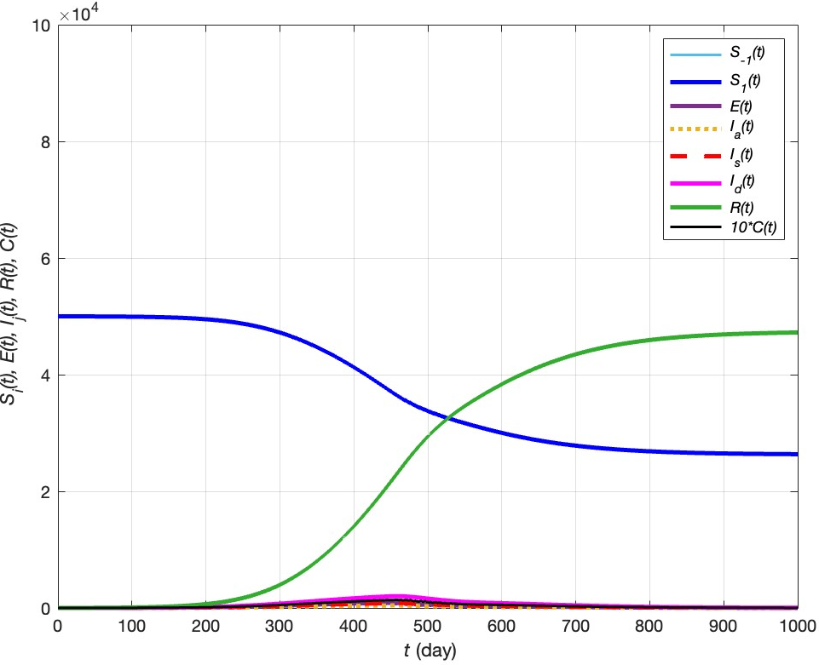


Scenario B’
${\text{Max}\text{(}C}_{t})=140$ new positives
$$R_{∞}\sim 47.23\%$$

Slide 31
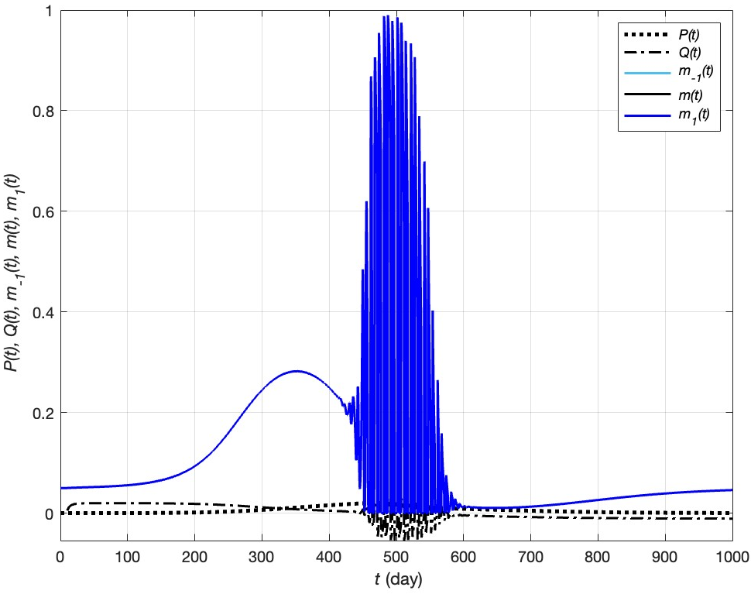
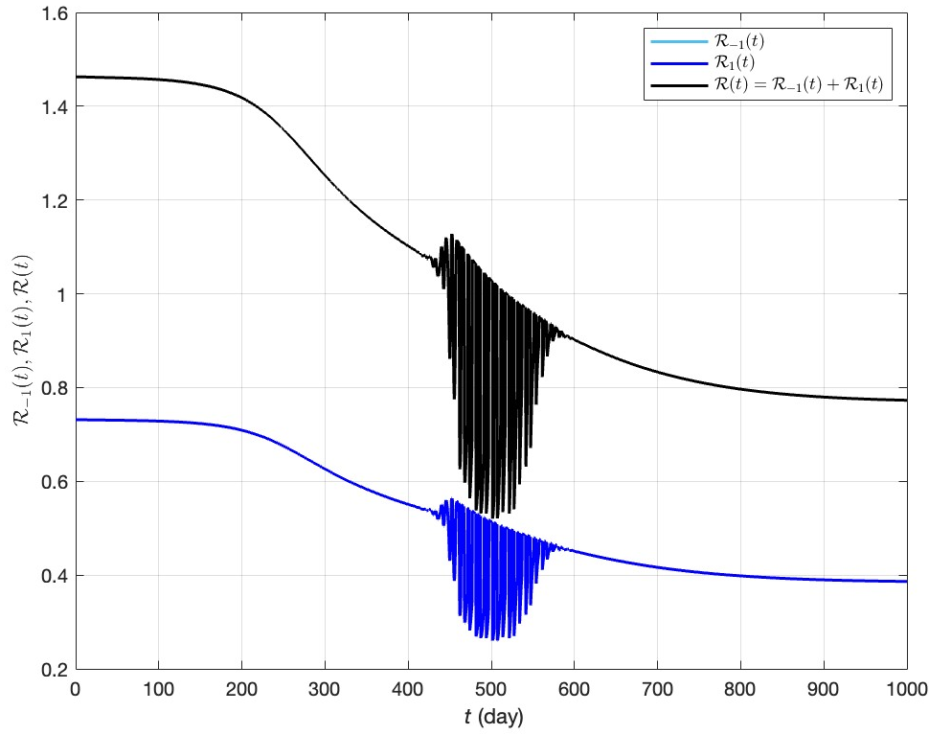
Scenario B’

Slide 32


Scenario B’’
Parameters | Role | Value
$$N$$ | Population size | 100 000
$$β_{0}$$ | Baseline contact rate | 0.2
$$σ,θ$$ | Incubation period | 1/2,1/5
$$π,γ_{a},γ_{s}$$ | Detection rates | 1/2, 1/30, 9/200
$$ρ_{a},ρ_{s},ρ_{d}$$ | Removal rates | 2/30, 1/200, 1/15
$$κ$$ | Efficiency of prophylactic behavior | 1/2 → 1
$$m_{0}$$ | Initial prophylactic proportion | 0.05
$$a_{−1},a_{1}$$ | Baseline prophylactic growth rate | 1/10
$$α_{−1},α_{1}$$ | Prophylactic growth shape | 1/100
$$u_{−1},u_{1}$$ | Response to prevalence | 100
$$v_{−1},v_{1}$$ | Response to rate of change of new positives | 10,100
$τ$ (day) | Delay in information acquisition and reaction time | 0.5

Slide 33



Scenario B’’
${\text{Max}\text{(}C}_{t})=$33 new positives
$$R_{∞}\sim 41.24\%$$

Slide 34


Scenario B’’

